Slide 1
Experiments in Economics Lecture 3
Calibrating the experiment; choosing parameters

Slide 2
Calibrating the experiment 1
This is probably the most important part of the design.
You need to understand the theory you are examining.
You need to calibrate the software so that it shows everything that the subjects need to see, and will work for the parameters you want to use.
You need to check the questions that you are going to ask the subjects and check that the software will accept any answers that are reasonable.
You need to select values for the parameters you want to use.
Choose the treatments you want to implement.
Separate the parameters that you want to leave fixed throughout the experiment/treatment from those that you want to change.
You should run a pilot experiment to test the parameter choice.

Slide 3
Calibrating the experiment 2
I use the word ‘calibration’ in the broadest possible sense:
Choosing the software and the layout of the screens that the subjects see.
Choosing different treatments (sessions of the experiment where something is fixed (for example, the cost of information in the experiment that you are designing).
Choosing the parameters in the experiment.
Choosing the payment mechanism and the relationship between ‘experimental money’ and real money.
Choosing the show-up fee.
Choosing whether you want a specific type of subject (for example, those studying finance).
You should run a pilot experiment to test your calibration.

Slide 4
A good Example from Buso and Hey on “Search and Switch”
Subjects were asked to imagine that they were buying something (for example, gas and electricity) from their ‘local’ supplier and were searching for something better. There is a search cost for each non-local supplier and a switch cost if the subject decided to switch to a non-local supplier.
Parameters: search cost c, switch cost s, the number and distribution of non-local offers.
We decided to have two treatments (to test the robustness of our results) with different values for the number and distribution of non-local offers.
We chose a set of c and s values to test the comparative static propositions from the theory.
The significance of such comparative static tests depends upon the noise in the subjects’ responses.
To get an idea of this noise, one can (and should) run a pilot experiment.

Slide 5
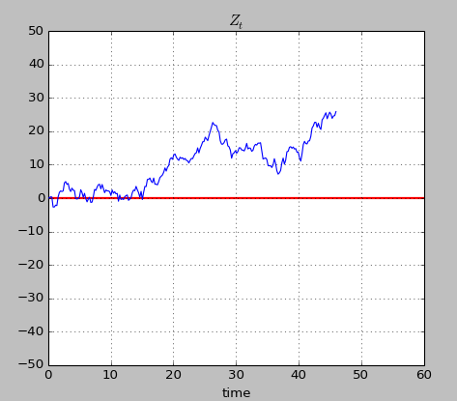
An example of bad calibration Taken from an experiment of mine with Konstantinos Georgalos and Martin Forster
This was investigating a theory paper by Epstein and Ji, “Optimal Learning Under Robustness and Time-Consistency” in Operations Research 2020.
It involves a decision problem in which the DM can bet on a colour from a two-colour – Red and Blue - each equally likely) risky urn or on a colour from a two-colour ambiguous urn, and can observe a costly noisy signal which gives information about the ambiguous urn.
The information is in the form of Brownian Motion with a positive (negative) drift if Red (Blue) is more likely than Blue.
In this picture, the information starts out confusing but then it becomes clear.
There is a cost for observing the information.
The key question is “how long should the DM observe?”

Slide 6
Theory
The theory (under the assumption of a Maximiner) says that the optimal strategy of the DM is to keep on observing until the motion crosses a threshold, which depends upon:
The drift of the motion
The standard deviation of the motion
The attitude towards ambiguity of the DM (characterised by a parameter epsilon).
The cost of observing
This assumes that the DM starts observing. It is optimal not to if:
The cost is too high
The drift is too low
The standard deviation is too high
The DM is too averse to ambiguity.
Our intention was to test the theory and to estimate ambiguity aversion (which is characterised by a parameter epsilon – the degree of ambiguity aversion of the subjects).

Slide 7
Parameters to be chosen
The drift of the motion
The standard deviation of the motion
The cost of observing
We wanted to estimate the attitude towards ambiguity of the DM (characterised by a parameter epsilon).

Slide 8
It was badly calibrated and (perhaps) badly explained to the subjects.
Too many subjects stopped sampling too soon…
…no epsilon value explained their behaviour.
We could not fit Epstein and Ji’s model to the data.
Too many observations were inexplicable.
We have run it again with better parameters.
We should have run a pilot experiment first.

Slide 9
How are you going to incentivise your subjects?
Crucial to Experiments in Economics are incentives.
Most economic journals will not consider for publication an experiment without incentives.
This is in stark contrast to psychology journals which are much more lax on incentives.
Almost always the incentive is money. (some psychologists use exam marks – we consider that to be unethical.
You should make it abundantly clear from the start how they will be paid.
Are you going to pay them on all problems or a randomly chosen one?
Are you going to pay all the subjects or some random subset?

Slide 10
End of Lecture 3
That is the end of Lecture 3 on calibration.
The next lecture is on “Software for implementing the experiment; testing the software”

